Slide 1
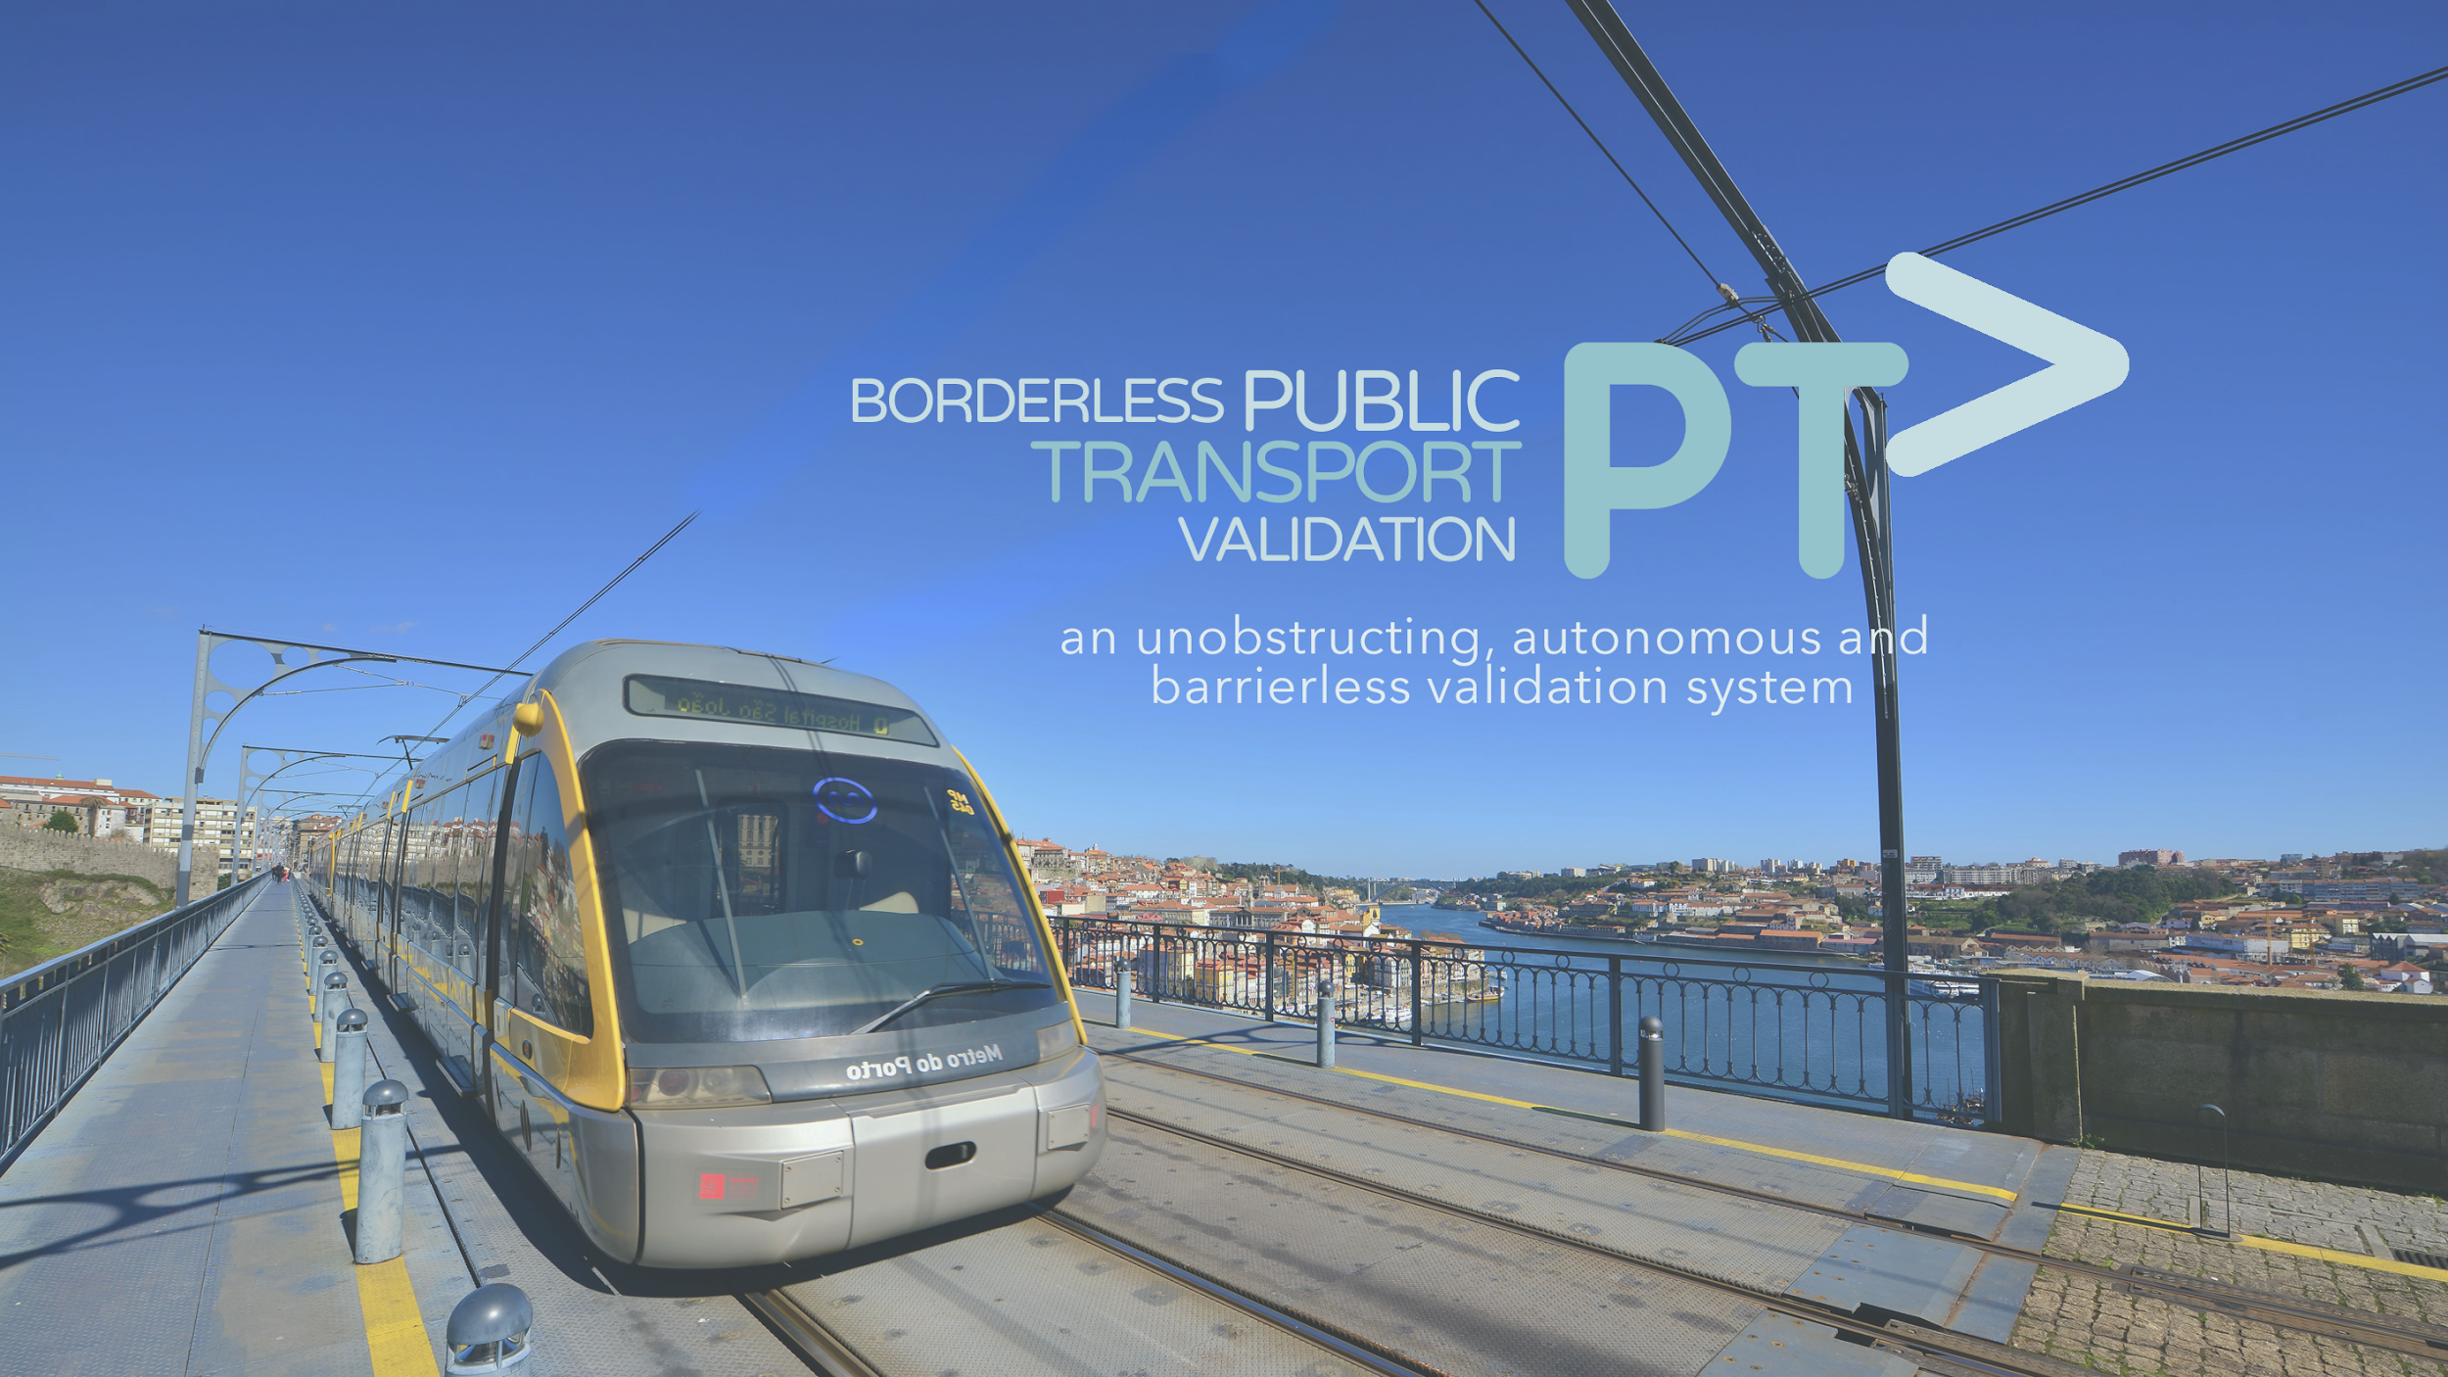

Slide 2






Final usability testing

Slide 3
Research questions
How is the sound affecting the system?
Should it be added to the final product?
How does it change the user’s experience to see the camera surveillance recording on a screen?

Slide 4
Research questions
Is enough information displayed in the posters?
Is there other important facts that should be mentioned?
Are the posters visible enough?
Do the users understand whats happening when observing one person validation and one not validating?

Slide 5
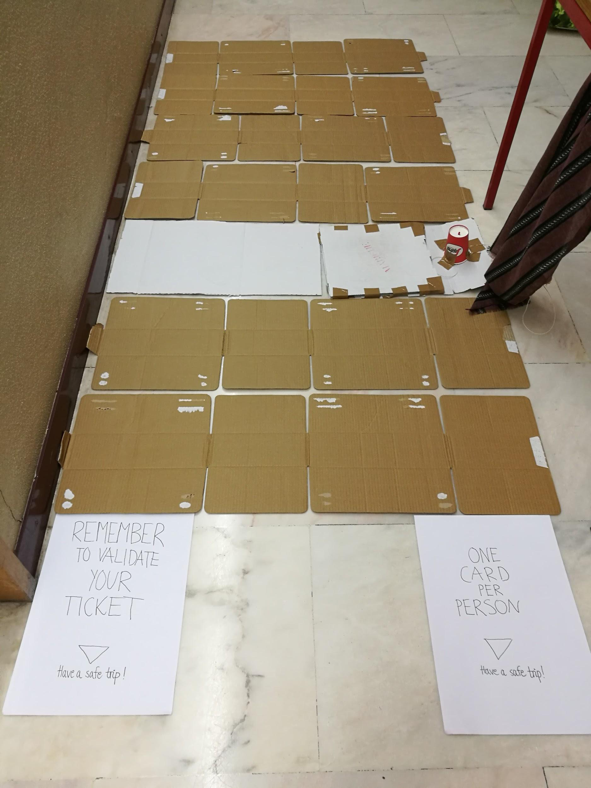
User research methodology
Direct observation, usability testing
11 users

Slide 6
Script - Preparation
Room and equipment
Civil building, hallway
Prototype, video camera, 3 computers (camera, notes and user form, hardware for the prototype)
Introduction to the user- inform about the project
Informed consent and pre-questionnaire- ask the user to fill in pre-questionnaire and consent in the Google form
User training, warm-up-trial - test in class and on the team members

Slide 7
Script - Conducting User Test
Explain short how the metro system works in Porto
The user is observing. One of us walk over without validating, the nex one validate.
What do you think is happening
Go through the system twice - one of the time you should validate, the other you should not. Decide the order of the actions yourself.
Questions:
Did the user notice and read the posters?
Do you understand the system by reading the posters?
Did you notice the red light?
What do you think the red light and sound represent?
Have you noticed the camera? Why do you think it is here?
Additional comments

Slide 8
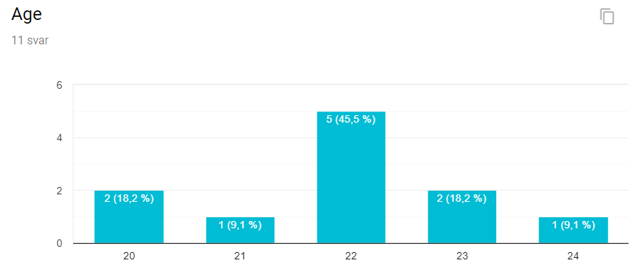
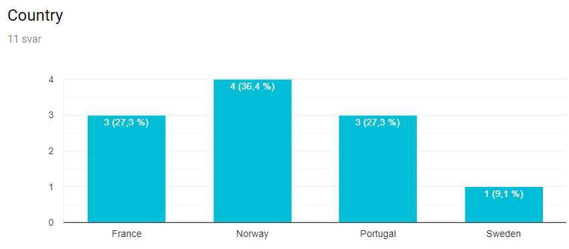
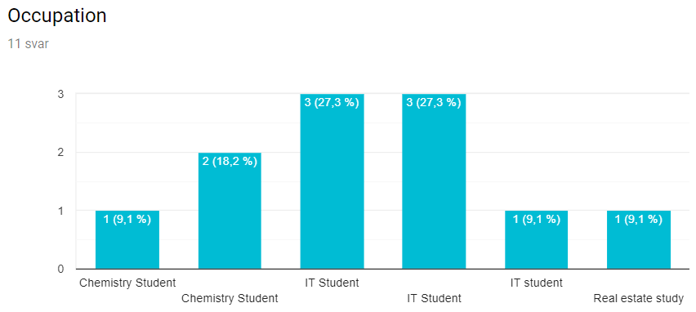
Test group
Notes:
To fill once the users created

Slide 9
Research questions
Is enough information displayed in the posters?
Is there other important facts that should be mentioned?
Are the posters visible enough?
Add information about the feedback from the system
Location: close to the validation machine
Do the users understand whats happening when observing one person validation and one not validating?
Yes

Slide 10
Research questions - Results
How is the sound affecting the system?
Should it be added to the final product?
We should add sound
How does it change the user’s experience to see the camera surveillance recording on a screen or not?
Did not change the users behaviour- more confusing

Slide 11
Debriefing
What went well?
What could be better?
What could be left out?
Feedback from the users?
Notes:
To fill once the users created

Slide 12
Improvements
Confirmation
Sound
Posters
Furthermore
Vibration
Commercial adds

